Slide 1
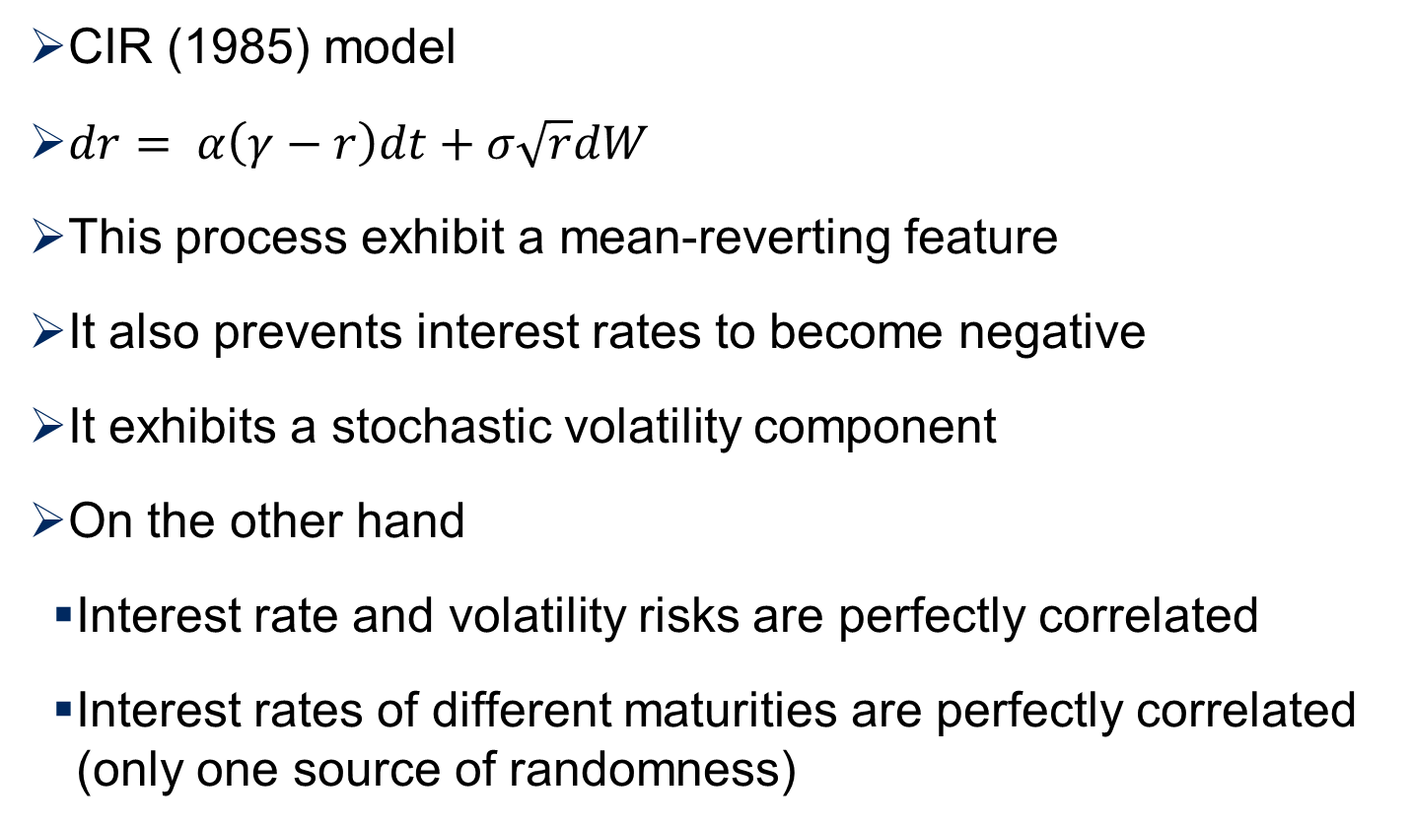
Cox-Ingersoll-Ross Model
www.yunikarn.com

